Slide 1
KSB Indonesia
The profile
December, 2024

Slide 2
About us
KSB Indonesia
Founded in 1871 in Frankenthal (Germany), KSB has been one of the leading suppliers of pumps and industrial valves for over 150 years. With more than 15,000 employees worldwide and its own sales and marketing, manufacturing facilities and service operations, KSB develops and produces custom-fit pumps for various applications.

Slide 3
In brief
KSB Group
Since 1993, KSB plays a major role in Indonesia by providing state-of-the-art products and services to multiple local industries product from standard to tailor-made products in accordance with customer needs and preferences. Supported by more than 400 employees, KSB Indonesia is committed to ensure customer satisfaction and continually improve for sustainable growth and development.

Slide 4
Cibitung plant extension
KSB Indonesia
Workshop extension from 3,620sqm to 9,620 sqm
New sandblast room & painting room
2 floor SupremeServ office with 2,000 sqm of workshop area
Solar panel system with a total capacity of 250kWp for electricity of office, factory, and service workshop

Slide 5
At a glance
KSB Indonesia
KSB Indonesia’s factory is located in Cibitung Industrial Estate, West Java, while sales offices, service workshops and service point are based in Jakarta, Surabaya, Lahat, Balikpapan, Banjarmasin, and Sangatta, coupled with representative sales in Cilegon, Semarang, Medan, Pekanbaru, and Makassar. Also, we are fully supported by associated partners.

Slide 6
Pumps
Best-in-class
There is hardly any industry that does not rely on effective and efficient pumps. Our customers have trusted in KSB’s innovative and reliable pumps for more than 150 years. They know that they can come to us with any challenge – and that we will jointly find tailored solutions and products that set standards.
.

Slide 7
Valves
World-class
Wherever our customers must shut off or control liquids and gases KSB valves have proven their worth. With diameters of 15 to 4000 millimeters and a nominal pressure between PN 6 and PN 500 our valves cover almost every application.

Slide 8
KSB SupremeServ
Service & Solutions
Customers rely on us for services matched precisely to their needs – classic and digital service concepts covering everything from consulting to planning, installation, operation, and maintenance.
KSB is on hand to help you over the entire life cycle of your system with more than 3,500 specialists in over 190 service centers around the globe. Supported by more than 50 dedicated employees for after-sales service activities in Indonesia.

Slide 9
KSB SupremeServ
Service & Solutions
In order to ensure our valuable customers and partners are fully supported in emergency cases, we provide 24/7 emergency hotline service:
Jakarta: 0811 940 2853
Kalimantan: 0811 940 2547

Slide 10
Pumps & valves testing
Manufacturing facility
Horizontal testing
Vertical testing
Amarex testing
High pressure testing
DnD testing
Dredger testing
Valve testing

Slide 11
Pumps & valves testing
Manufacturing facility
The facilities are designed to meet the international standard for pump performance tests in accordance with ISO 9906:2012, Hydraulic Institute, and API 610 12th edition, commence wide range of testing (pump performance, NPSH, mechanical running, hydrostatic test, vibration, temperature, noise, and solo run Electric AC motor performance).

Slide 12
Machining
Manufacturing facility
5 Lathe Machines
1 Milling Machine
1 Drilling Machine
1 Slotting machine
1 Grinder
1 Balancing Machine

Slide 13
DnD pump assembly
Manufacturing facility
6 Line Assembly
1 unit Laser Alignment
Air and power tools
Portable drill and tap machine
Induction Bearing Heater
15 tons Overhead Crane

Slide 14
DnD pump assembly
Manufacturing facility
6 Line Assembly
1 unit Laser Alignment
Air and power tools
Portable drill and tap machine
Induction Bearing Heater
15 tons Overhead Crane

Slide 15
Standard pump assembly
Manufacturing facility
3 Small Assembly table
2 Big Assembly table
2 sets Laser Alignment
Laser marking machine
Pipe threading machine
Air and power tools
Overhead Crane 5-15 tons

Slide 16
DnD pump assembly
Manufacturing facility
6 Line Assembly
1 unit Laser Alignment
Air and power tools
Portable drill and tap machine
Induction Bearing Heater
15 tons Overhead Crane

Slide 17
DnD pump assembly
Manufacturing facility
6 Line Assembly
1 unit Laser Alignment
Air and power tools
Portable drill and tap machine
Induction Bearing Heater
15 tons Overhead Crane

Slide 18
Fabrication
Manufacturing facility
Welding Machine
GTAW 3 units
GMAW 17 units
SMAW 1 units
Cutting Machine
CNC Gas
CNC Plasma
Bandsaw
Rolling machine
Bending Machine for plate and pipe

Slide 19
Sandblast and painting
Manufacturing facility
Blasting Room and Panting booth ready for skid or base frame with maximum dimension: 12 m length, 4 m width, and 1 m height

Slide 20
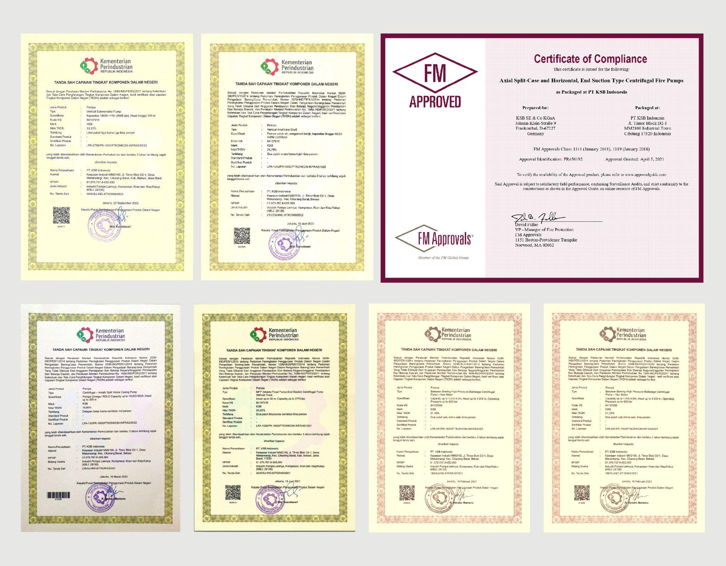
Certificates
Premium quality standards
KSB always works to the latest quality standards, in all areas of the company worldwide. First-class products and excellent service take top priority at KSB. That is why the entire Group works to uniform and secure quality guidelines based on the Business Excellence Model of the European Foundation for Quality Management (EFQM). The products have also been certified to the national standards as part of our initiative in improving local content requirement/Tingkat Komponen Dalam Negeri (TKDN).

Slide 21
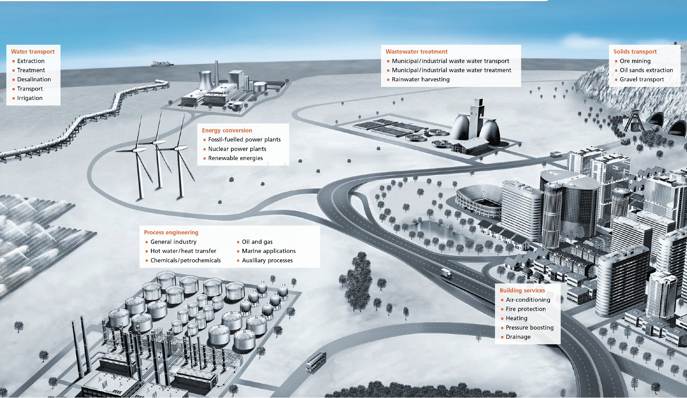
A wide range segment
Comprehensive Solutions
Name any application, KSB pumps and valves are ready in action. Like industrial processes, water transport or energy conversion. All around the world, customers rely on our expertise and technical skills to keep things moving.

Slide 22
Delivering on promises
Our Success stories
Our reliable, high-efficiency pumps and valves are used in applications wherever fluids need to be transported or shut off, covering everything from building services, general industry and water transport to wastewater treatment, chemical/petrochemical, power plant processes, and mining.

Slide 23
Mining
Our Success stories
Striving to provide best-in-class solutions and service excellence in mining market in Kalimantan, Sumatra, and Sulawesi to support Indonesia’s government continuous works on stimulating the development of in-country processing facilities. Serving export market: Australia and Malaysia.

Slide 24
Energy
Our Success stories
Energy is one of the most important inputs that supports Indonesia’s economy. As Indonesia is aiming to add 4.7 GW of solar capacity by 2030 under its new Electricity Procurement Plan (RUPTL) that will boost the contribution of renewables to the mix, our comprehensive solutions effectively reduced power operation as well as support the government initiative in increasing the use of new and renewable energy.

Slide 25
Chemical/ Petrochemical
Our Success stories
In onshore and offshore extraction, in refineries, intermediate storage and downstream applications – KSB products make sure the natural resources are processed safely and reliably. As the oil and gas resources continue to play an important role in Indonesia’s economy, KSB best-in-class solutions also make sure smooth processes, protect people, and the environment.

Slide 26
Water
Our Success stories
The increasing need of a clean water increases significantly with the growth of population resulting in a larger amount of demand for water sources. KSB
solutions generate efficiency and benefits from low energy footprints, bringing clean water for more than 1 million people, supporting water supply systems in East Java and Sumatra as part of the national strategic projects in delivering more clean water for Indonesian lives.

Slide 27
Wastewater
Our Success stories
KSB supplies pumps and valves for wastewater applications that work reliably and efficiently even under the most difficult conditions – whether in wastewater treatment, wastewater disposal or flood control.
Delivering flood control solutions in Java to mitigate the risks and minimize the damage. Providing pump on wheels for draining inundation and alleviating frequently flooded area within minutes of arriving.

Slide 28
Building Services
Our Success stories
A holistic approach to project planning and implementing is essential for supply technology
for buildings, offering the right solution for every project in small-scale and large-scale building applications including commercial and administrative buildings, factory buildings, and residential. Our range includes single components for drainage, water supply and all heating and air-conditioning circuits as well as fully integrated, highly efficient systems including world-class quality of fire-fighting pump sets.

Slide 29
General Industry
Our Success stories
Industrial pumps and valves from KSB are designed for almost all applications in industry and work under the harshest conditions while achieving the highest levels of reliability.
KSB pumps and valves for industry find use in a wide range of industrial applications from chemical industry, food and beverages, paper, textile, metal industry, and mechanical engineering– and these examples offer only a glimpse of the products’ extensive versatility applied in Indonesia.

Slide 30
Valves
Our Success stories
KSB valves are used in power stations, mining applications, buildings, in process and water engineering systems. Alongside globe valves, gate valves, butterfly valves, ball valves, diaphragm valves and check valves, the product range also includes actuators and positioners. This diverse product spectrum complements the Group's broad range of pumps, leaving it well positioned to offer all-in solutions for hydraulic applications in Indonesia.

Slide 31
KSB Guard
Digitalization
KSB Guard is a quick and easy introduction to the world of KSB
smart services, an intelligent pump monitoring system comprising sensors and a cloud application which enables you to always keep a mobile eye on the performance and status data of your pumps. KSB Guard can be quickly attached to your pumps and immediately helps you to make your system more reliable and reduce your operating costs.

Slide 32
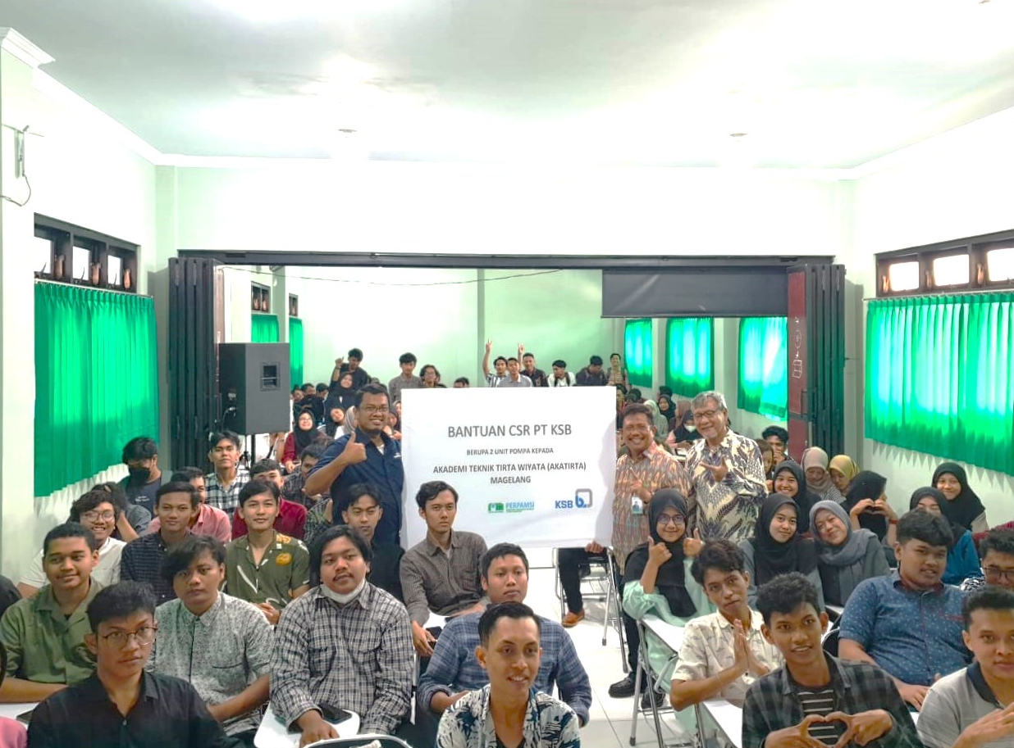
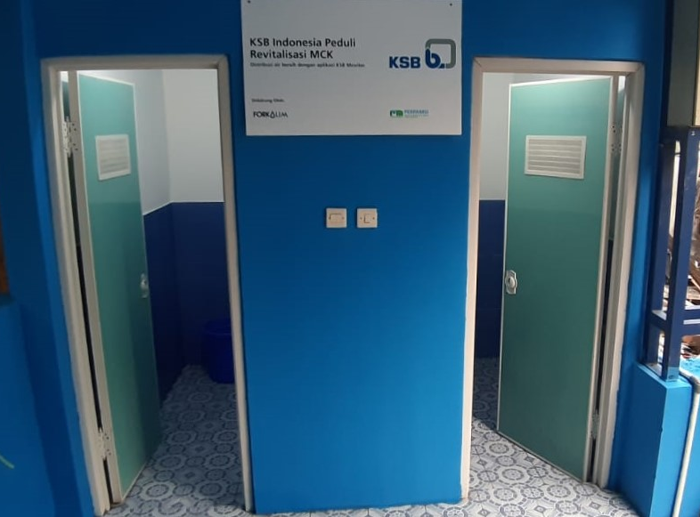
The initiatives
CSR
Sustainability and corporate social responsibility (CSR) are integral part of KSB’s corporate culture. This is why KSB is a signatory to the UN Global Compact. Our CSR initiatives reflect on how we conduct our business, have more positive impact on society and environment as well as enhance sense of caring for others.

Slide 33
Contact us
KSB Indonesia Head office & factory: Jl. Timor Block D2-1, MM2100 Industrial Town Cibitung 17520
Tel. +6221 8998 3570
Sales & Marketing office: Secure Building Blok A, 1st floor
Jl Raya Protokol Halim Perdana Kusuma Jakarta 13610
Tel. +6221 8088 6509
Email: ksbsales@ksb.com
Website: https://www.ksb.com/en-id

